Slide 1

Puzzle Box Website
“Agnes wants to die” puzzle

Slide 2
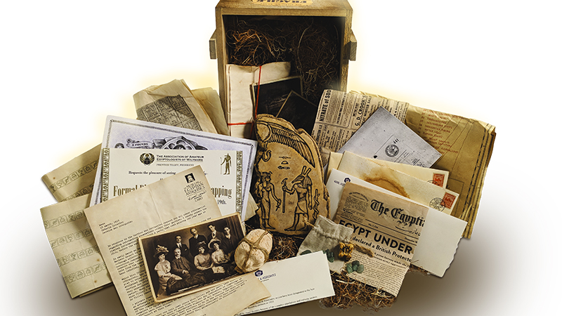
Puzzle Website
Using Bootstrap and JQuery
Based on puzzle box project designed in another class
Theme: Escape an AI in an underwater base

Slide 3
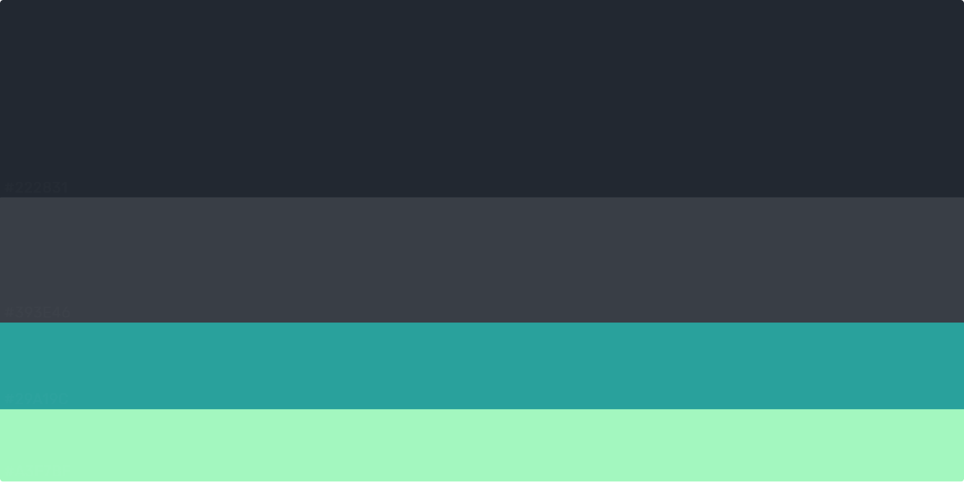
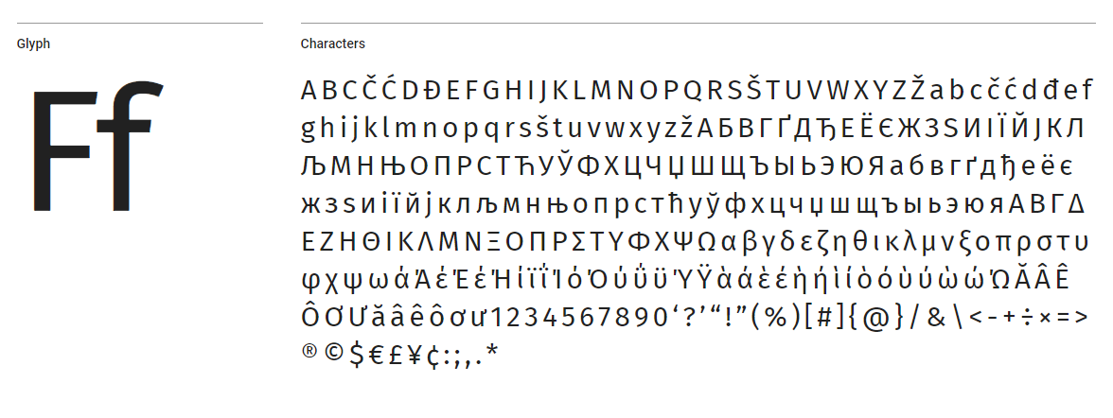
<link href="https://fonts.googleapis.com/css?family=Fira+Sans&display=swap" rel="stylesheet">

Slide 4
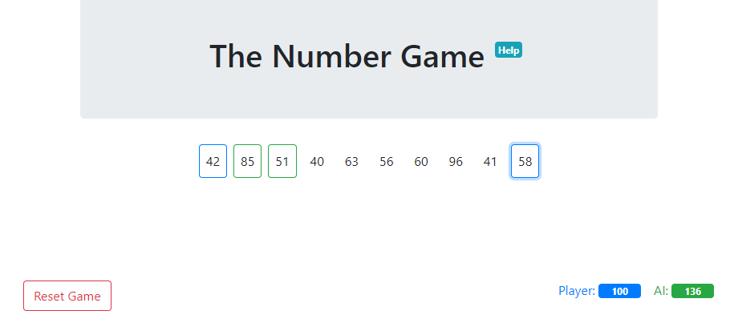
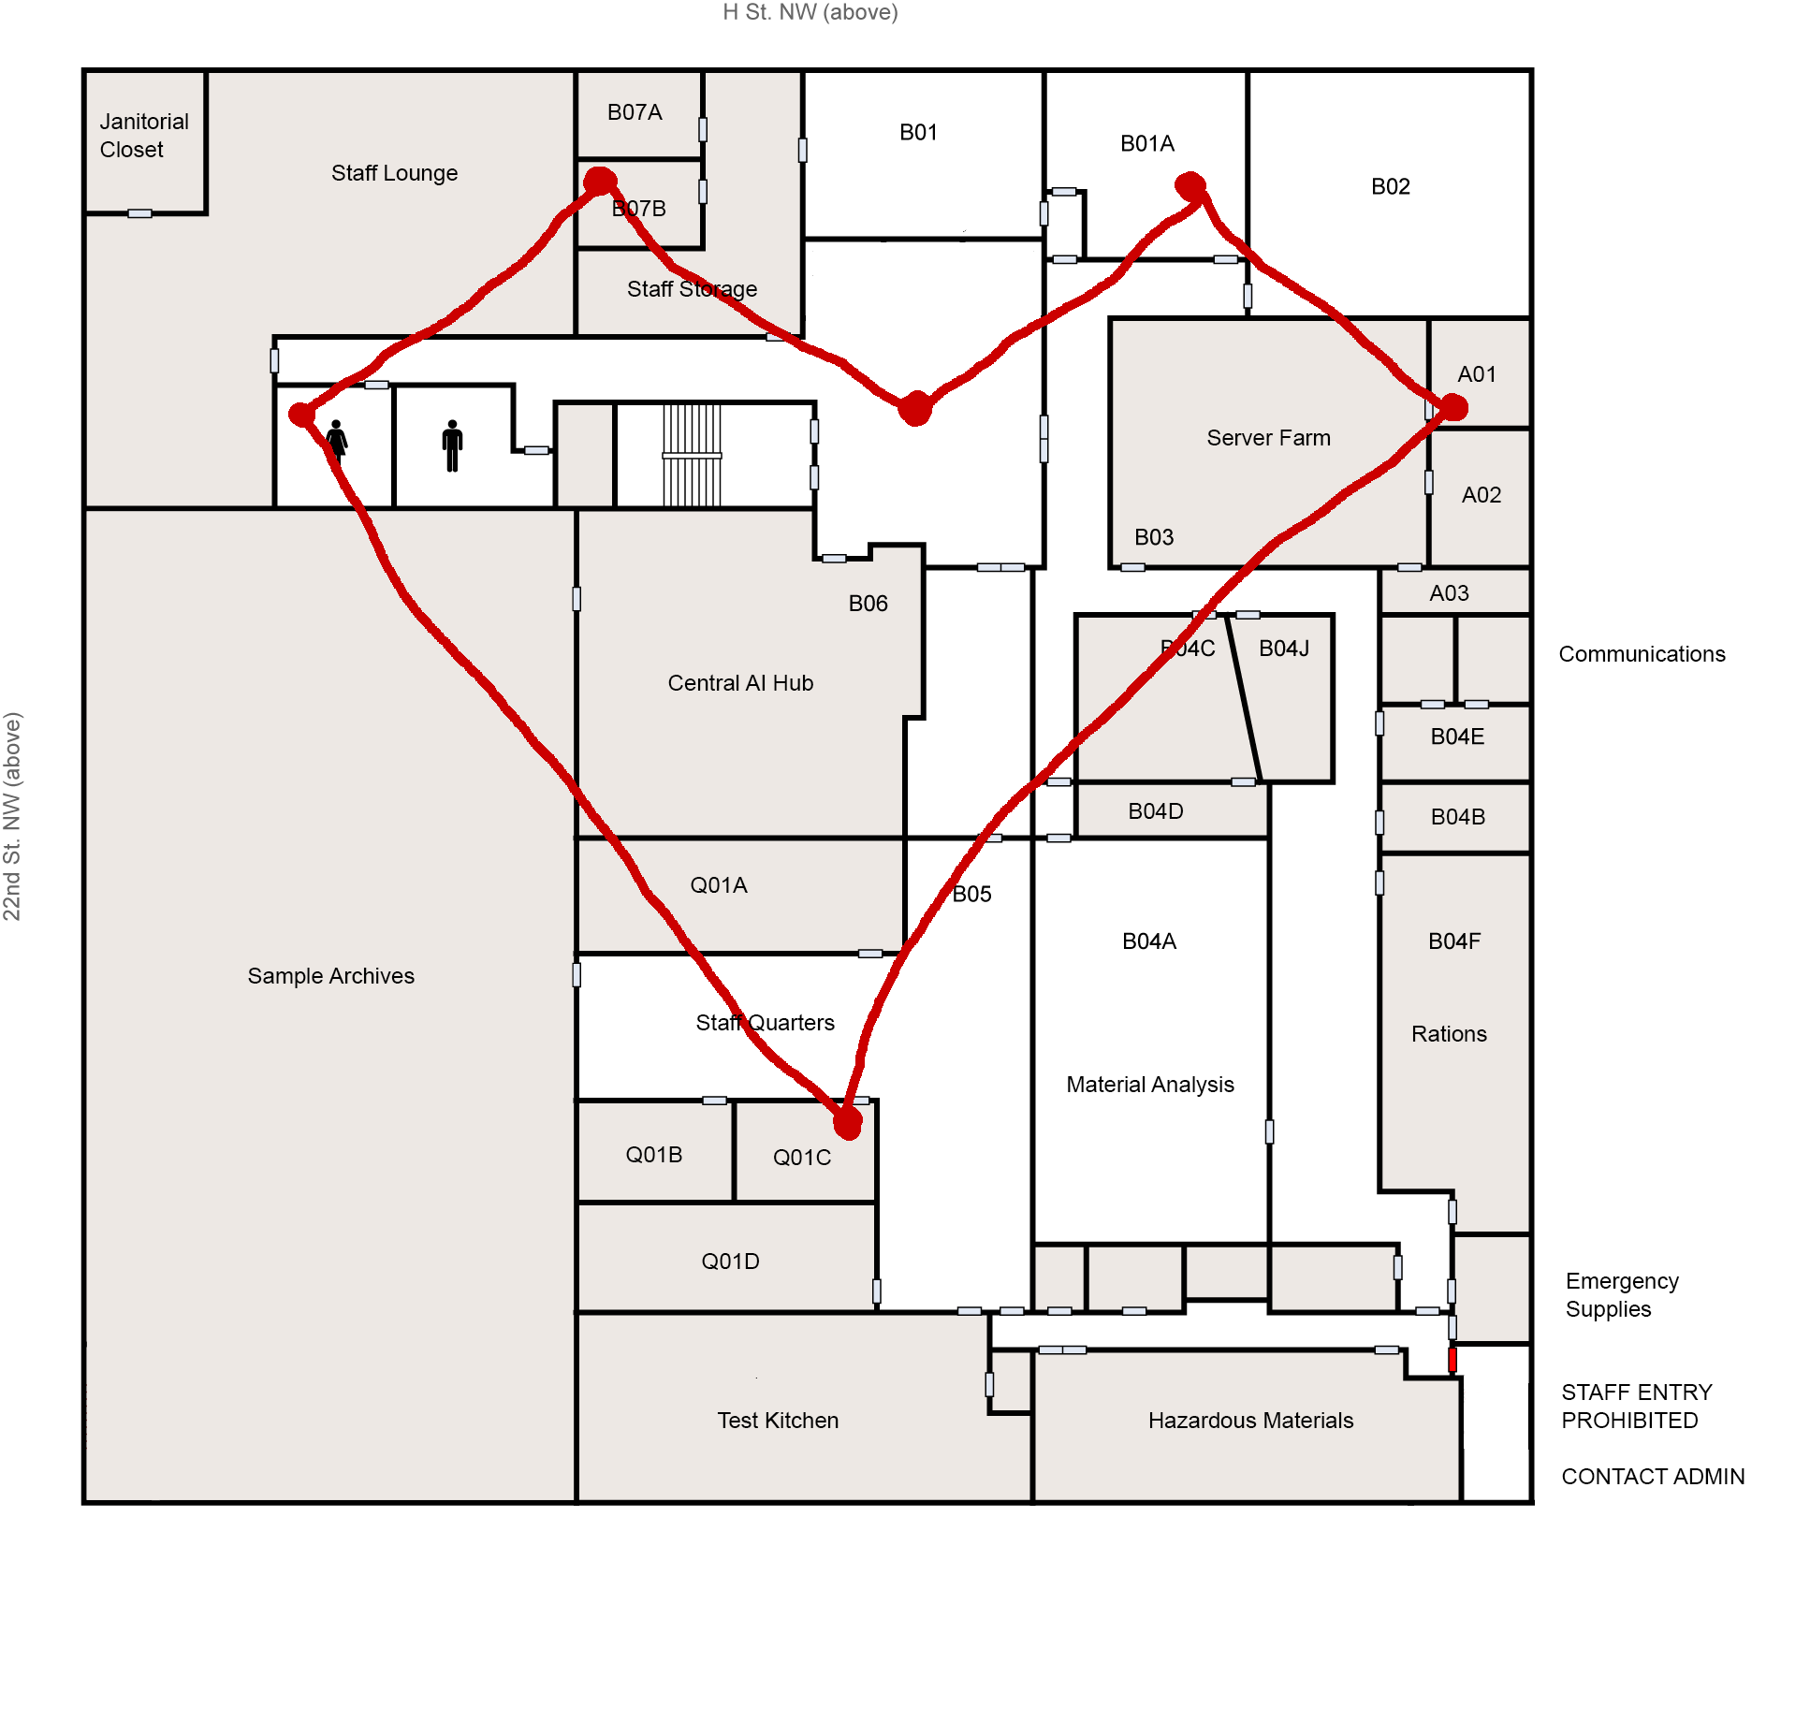
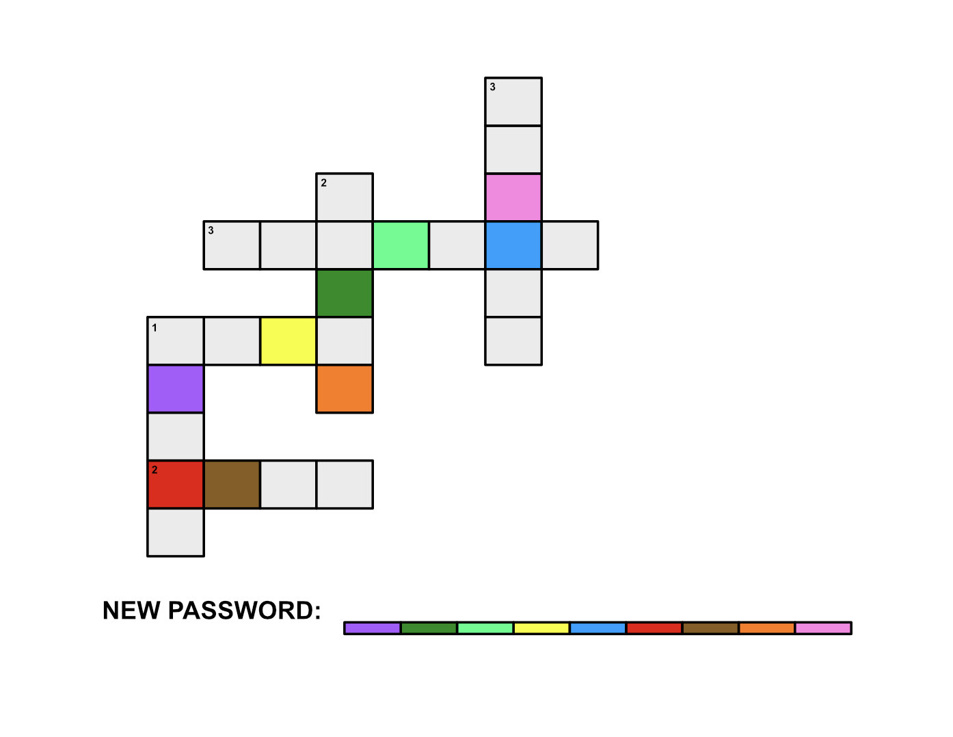
Email Puzzle -TODO print
keyboardpapi@protonmail.com
So great to meet you!
My name is Agnes! I’ll be forwarding your emails from the outside world and generally assisting you! Your password is agnes2019. Feel free to change your password although I get the feeling you won’t. All passwords in the system must be a word and four numbers.
Looking forward to exploring science with you keyboardpapi@protonmail.com
Love, Agnes
Forwarded Email From “Your Last Loved One”
If I could unleash the fury of a thousand suns on you I would still need an additional sun.
------
eng4153@gmail.com
Hello,
You can call me Agnes! I will be your artificial assistant on this adventure, forwarding your mail and other monotonous things. The world sure is full of monotonous things. Your email is eng4153@gmail.com. Please create your own password. I’m too busy looking at pictures of cracked concrete.
My condolences, Agnes
Forwarded Email From “Your Mother Please Call Me Back”
Congrats on the job honey. Please take lots of pictures of your adventures and friends!!! We love you and are so proud of you! Also, we’re letting you know that your dog Scooby just passed away, we couldn’t figure out what kind of food he liked. Please let us know if this is ok for his eulogy: “RIP Scooby, starving at the tender age of 21, in the year of our lord 2049”.
------
legalizesushi18plus@protonmail.com
Sup.
This is Agnes. I’ll be your spirit guide on this science misadventure. I’m like, so into helping you out as your new artificially intelligent virtual friend of sorts! Your email is legalizesushi18plus@protonmail.com. I don’t want to step on your toes, so please create your own password.
Fight on, Agnes
Forwarded Email From “Your Least Favorite Sister”
What’s up nerd! Haha just kidding omg I can’t believe I just wrote out haha haha. Anyways, just wanted to let you know Happy 46th birthday! It’s crazy you and that movie were made in the same year! Ew right? And your friend Agnes is like so cool. I’m sorry we can’t watch Finding Nemo this year, but you should totally watch it with Agnes! I know you just love that fish!

